Slide 1
Ringforts of Ireland
Cross-Platform Mobile App
David Corrigan
Higher Diploma in Computer Science

Slide 2
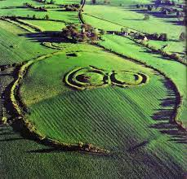
Ringforts
Built as protective enclosures
Early Christian period 500-1100AD
Estimated 60,000 on the island
Ráths or fairy forts

Slide 3

Project Objectives
Mobile App to find and record Ringforts
Intuitive to use
Cross Platform Solution (Android & IOS)
National Monument Services Data
Learn a new technology

Slide 4
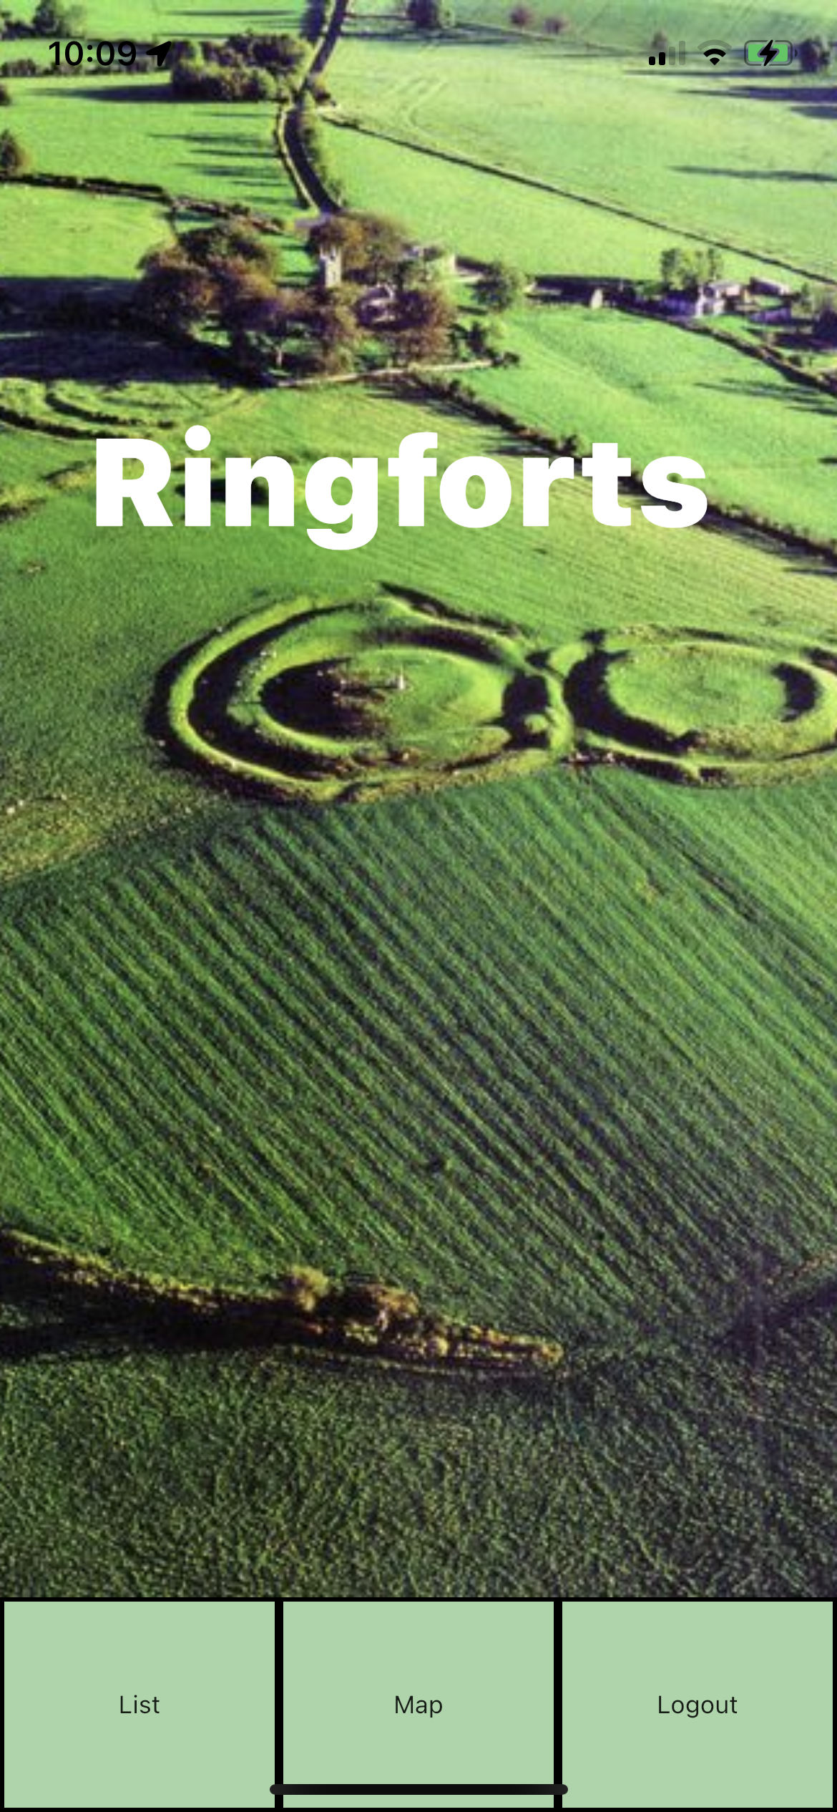
Mobile App Live Demo

Slide 5
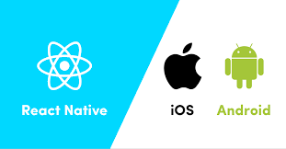

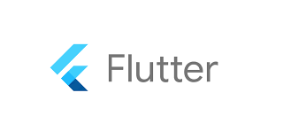
Front End Options
Richer more consistent cross-platform UI experience
Faster development environment
Closest to Native performance
Great documentation and resources available
Opportunity to learn a new framework and programming language

Slide 6
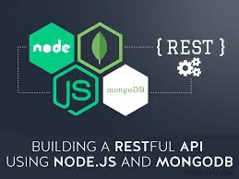


Backend Options
Flutter Integration
Pricing plans
Speed of development using Firebase services
Scalability
Availability

Slide 7
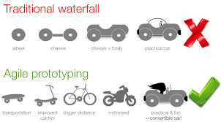
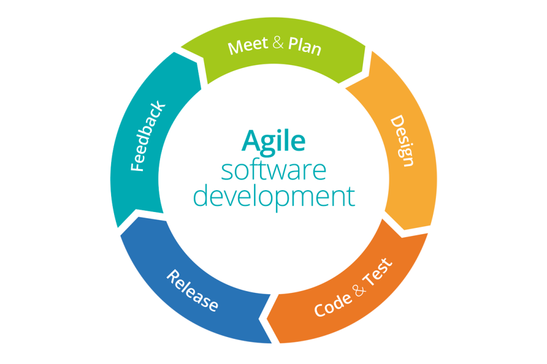
Project Methodology
Why
Expert User Meeting
Hand drawn screens
Reviewed with Expert User
Wireframe design
User Stories
Sprint Planning
How

Slide 8
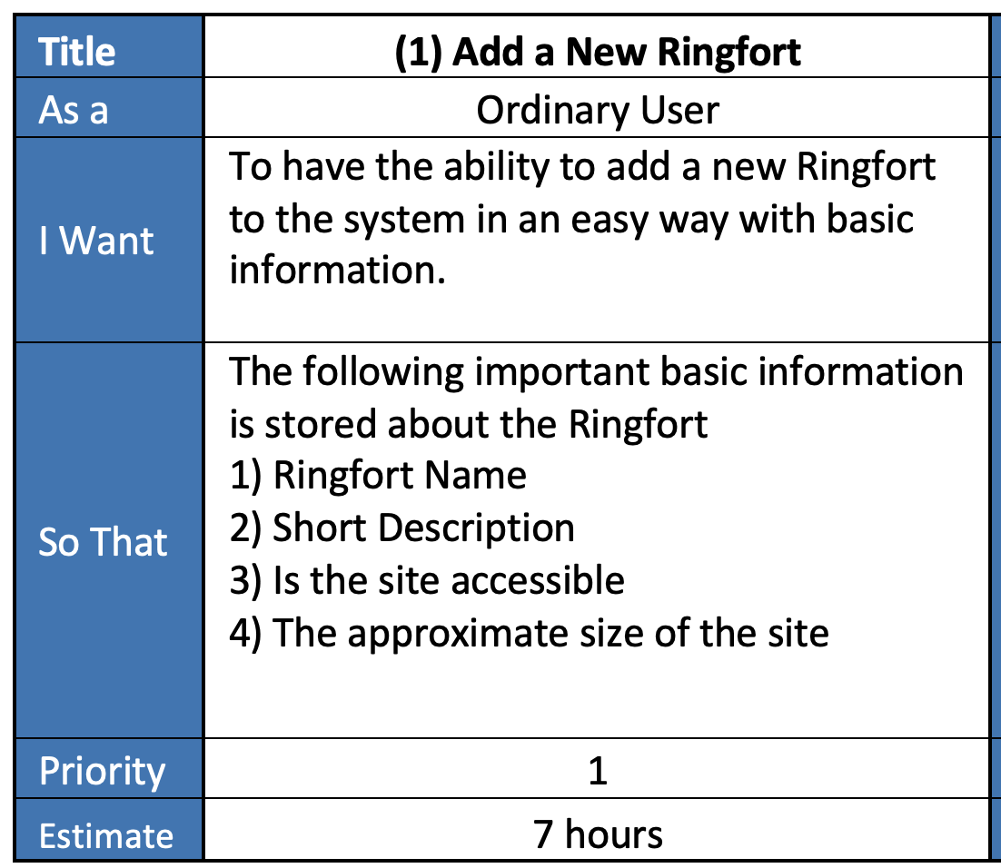
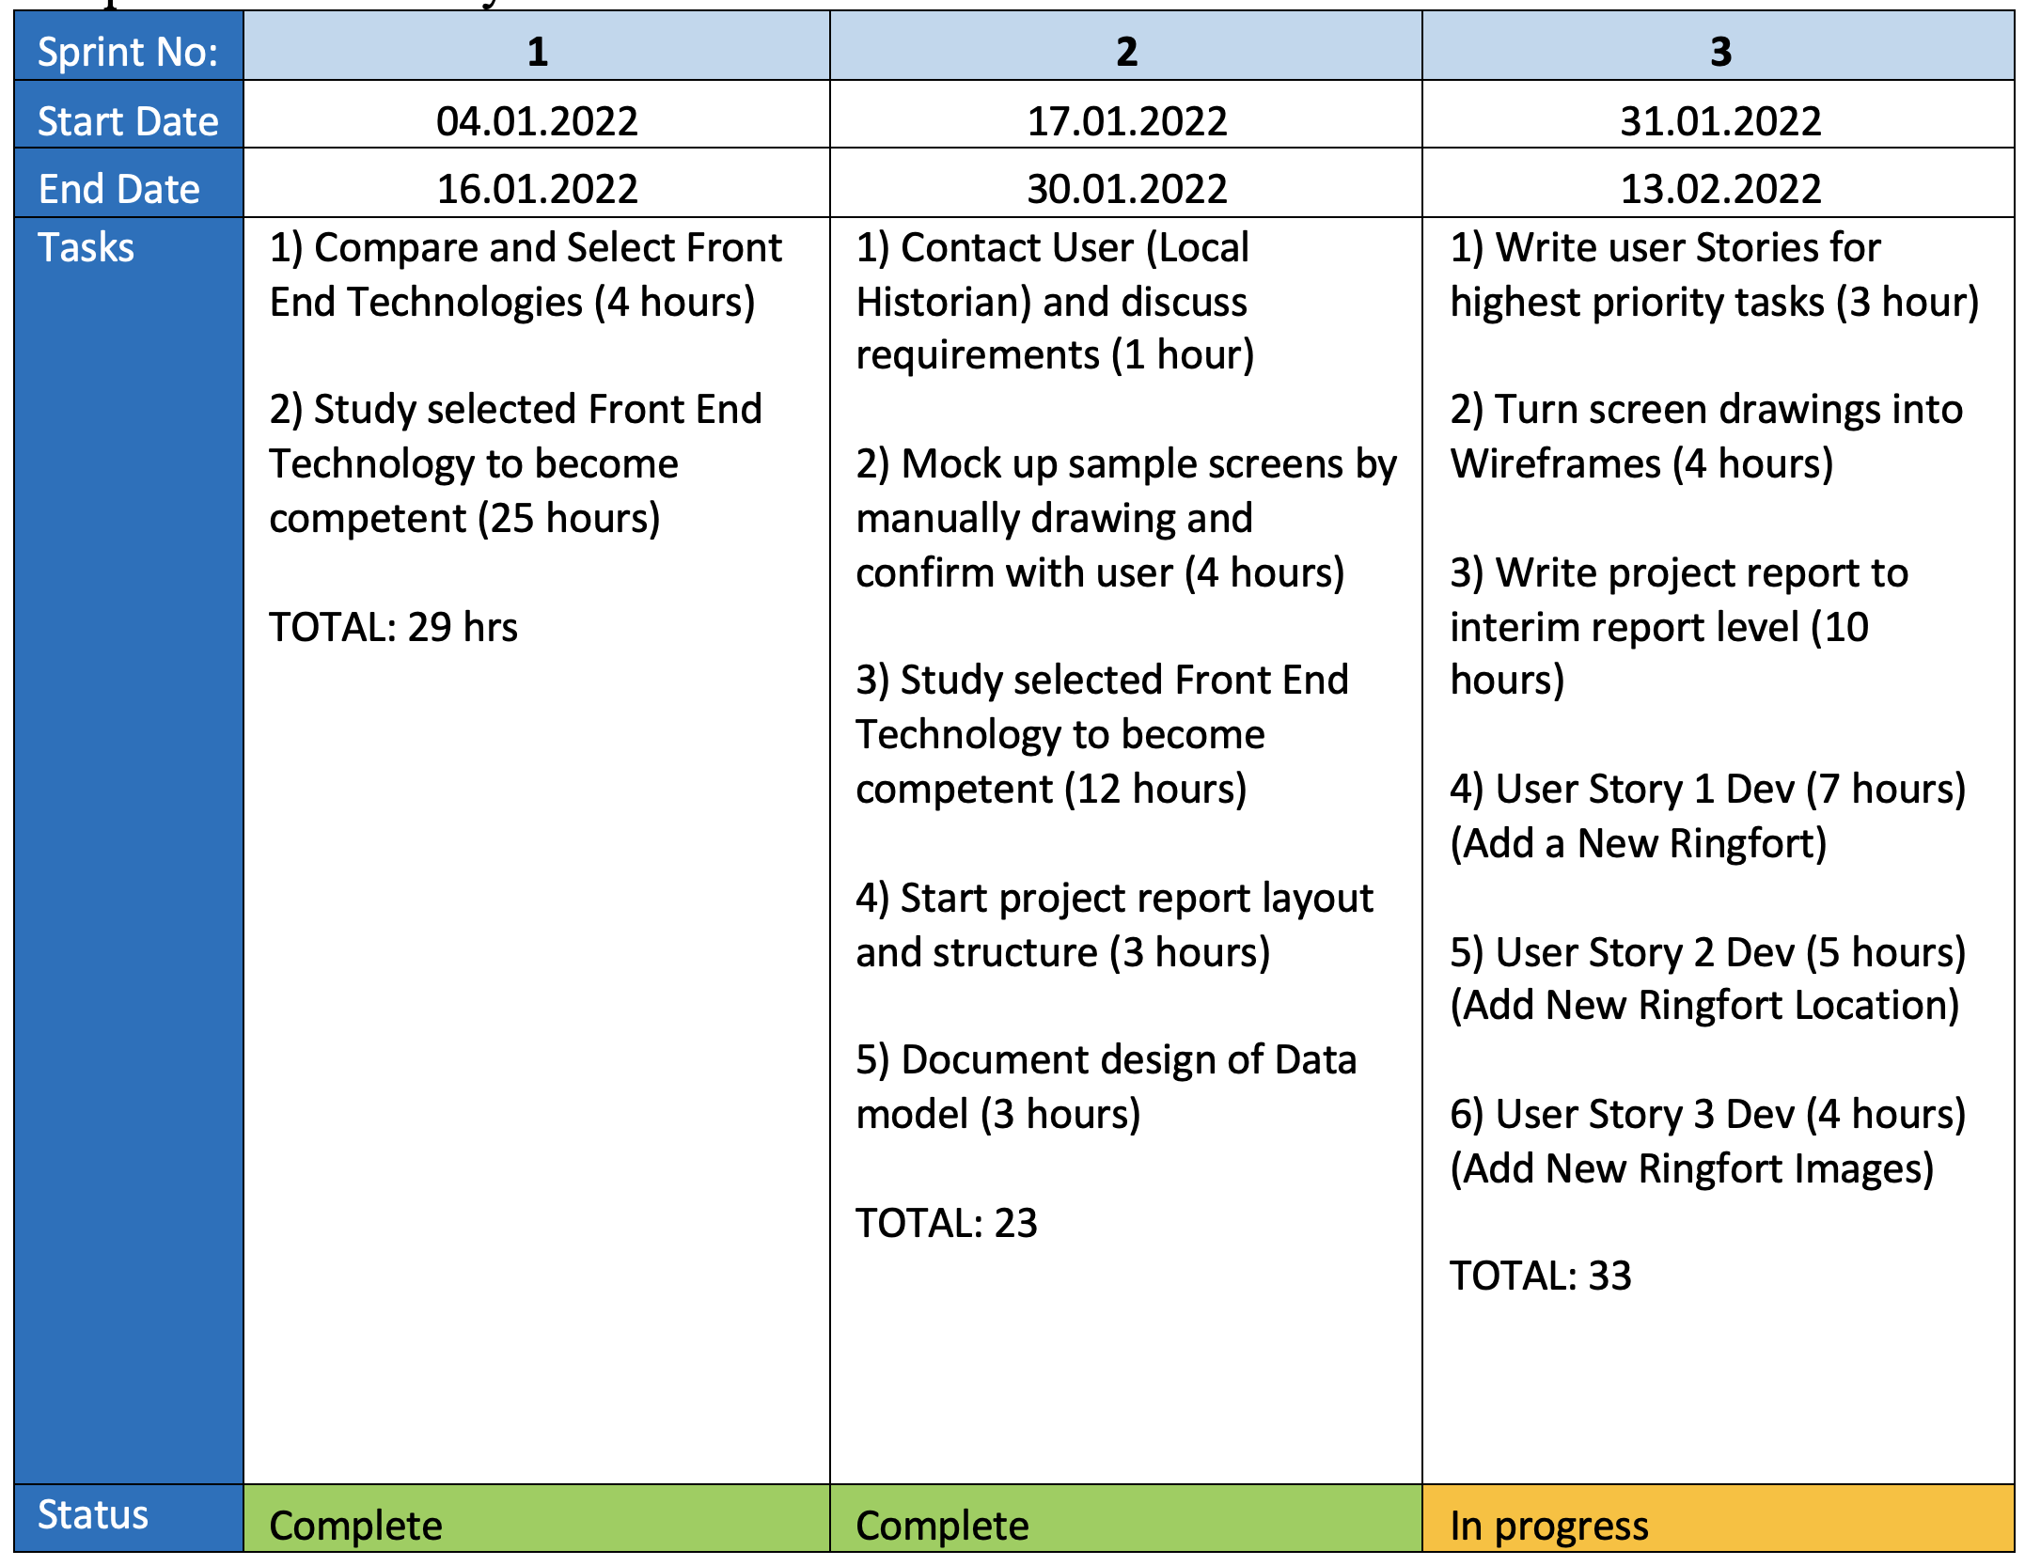
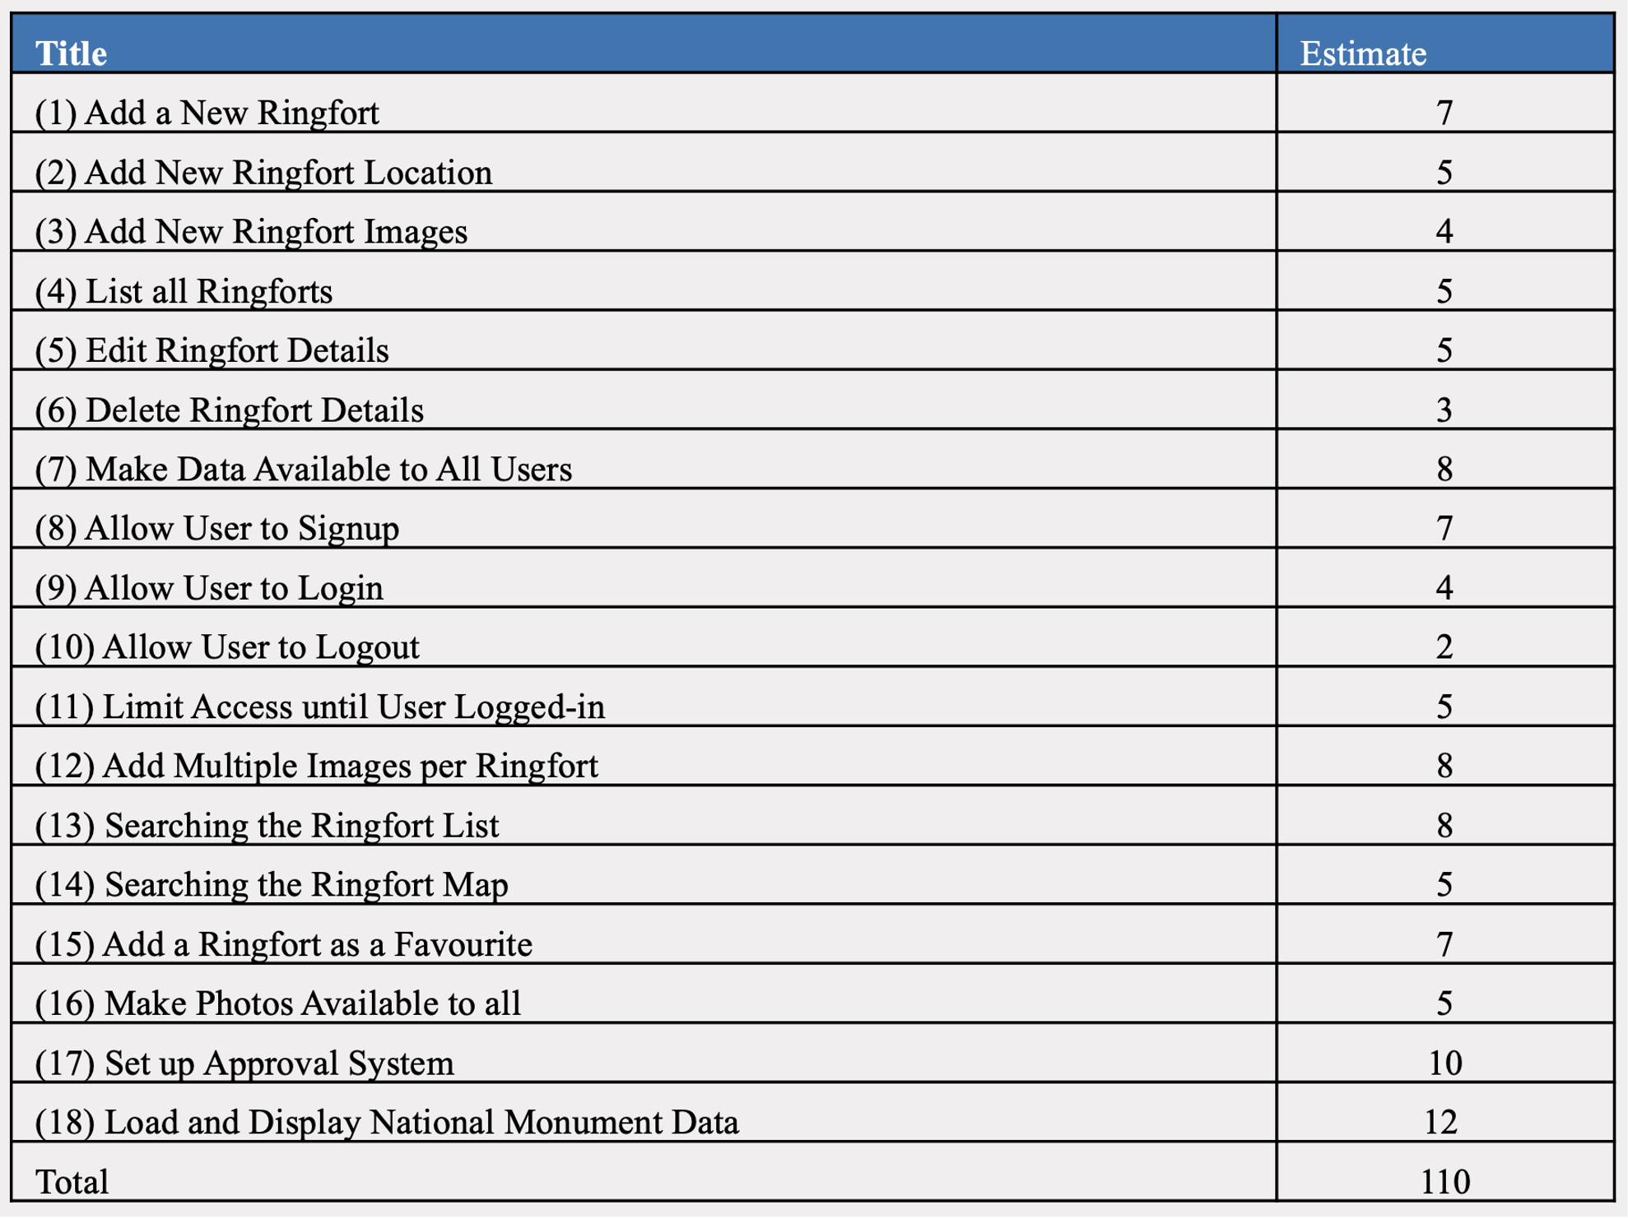



Sprint Planning
User Story
Sprint
Planning
User Story
List

Slide 9
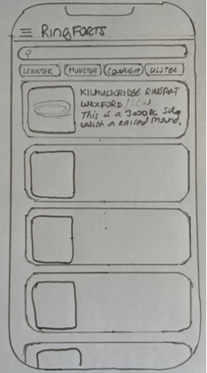
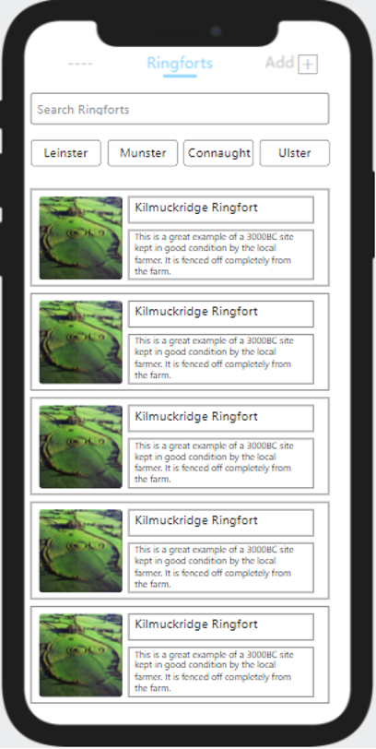
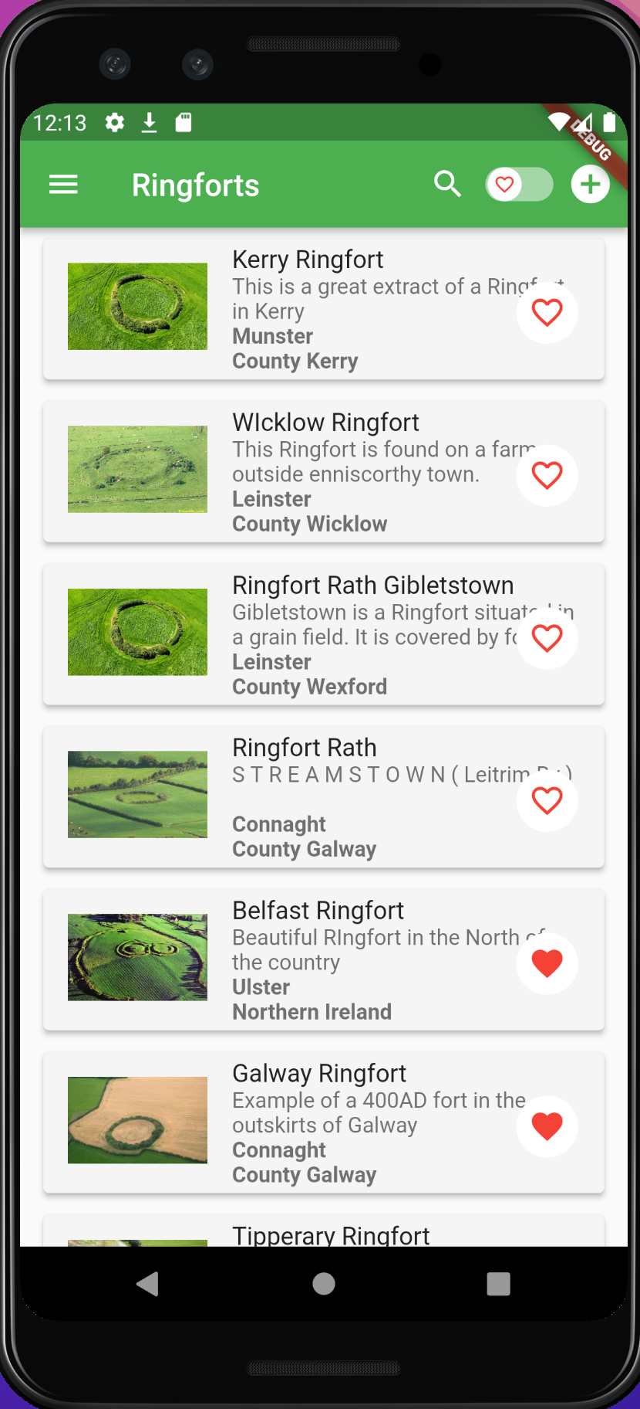
Evolution
Evolution of Design
Initial Hand drawn prototype
Mock-up using on-line tool
Finished Screen

Slide 10
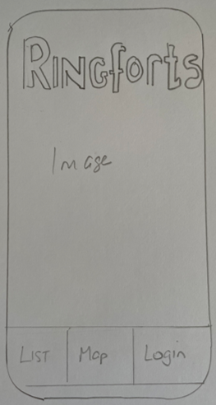
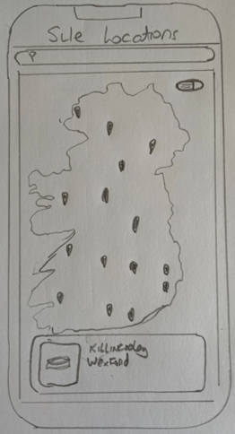
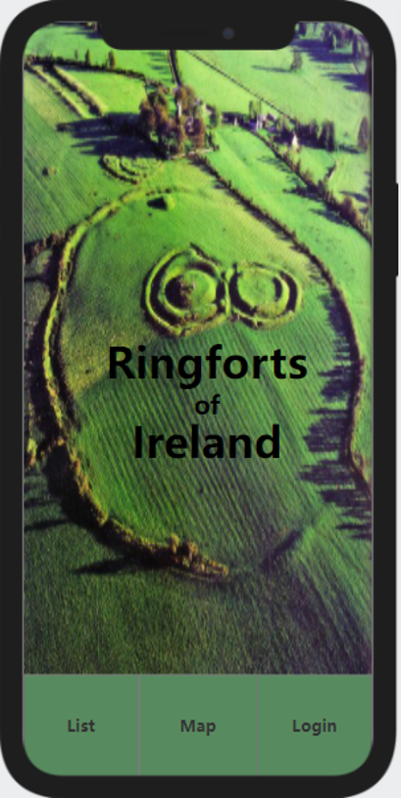
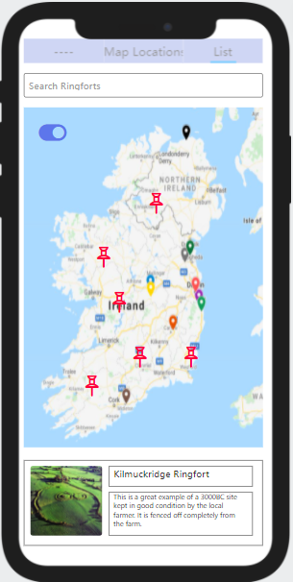
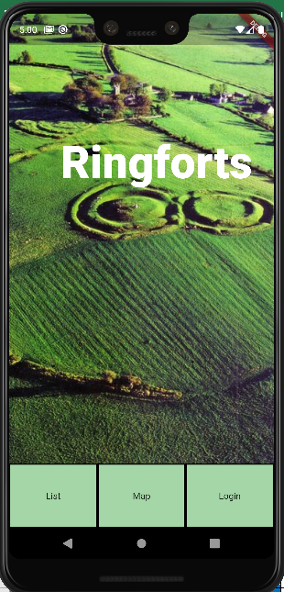
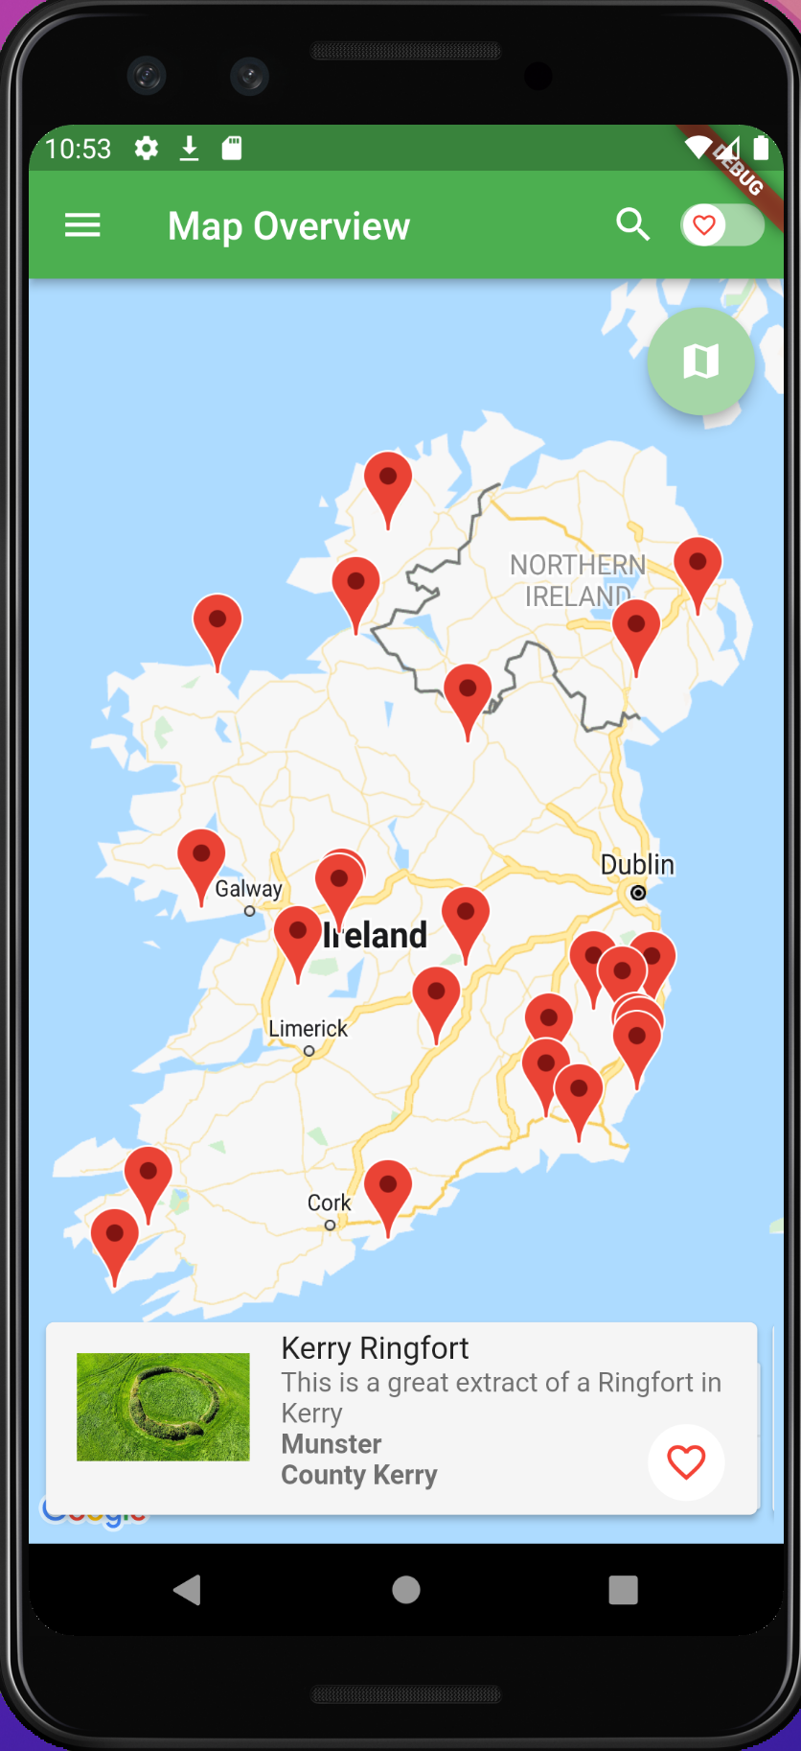
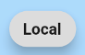
Evolution of Design

Slide 11
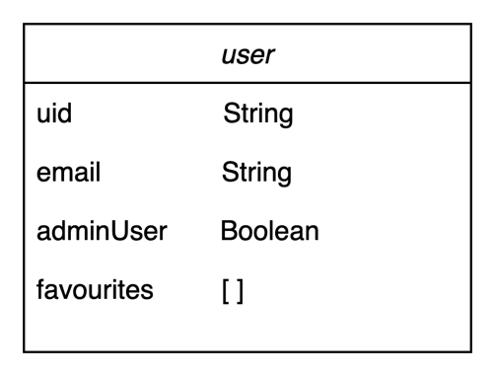
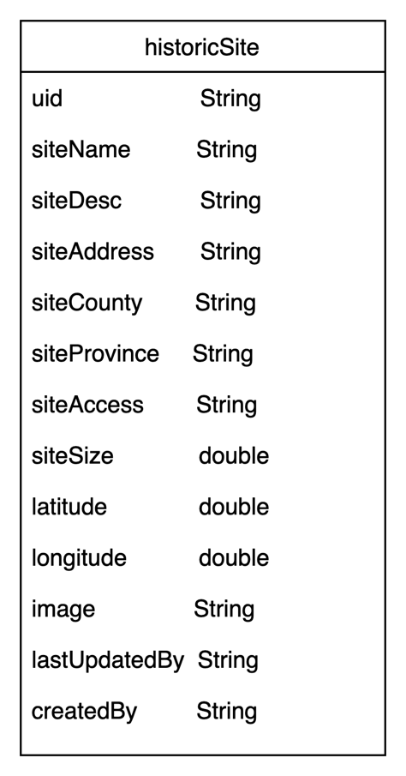
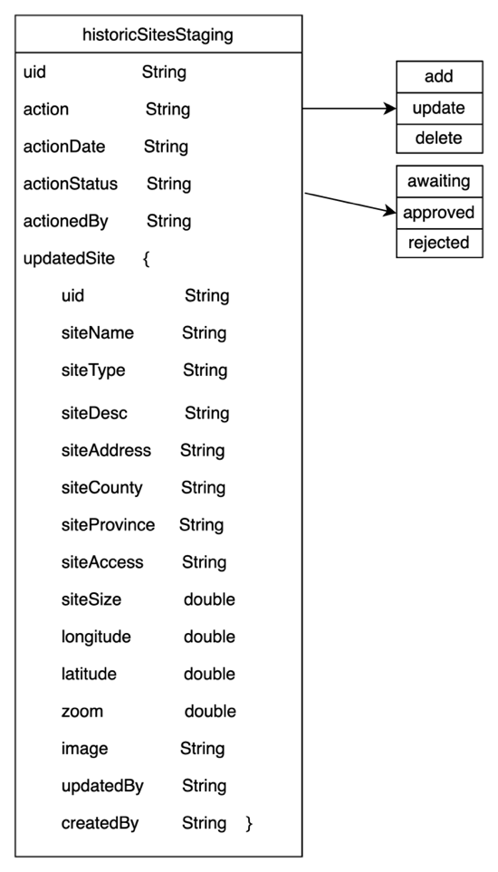
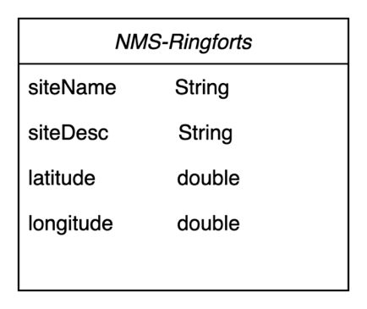
Data Model

Slide 12
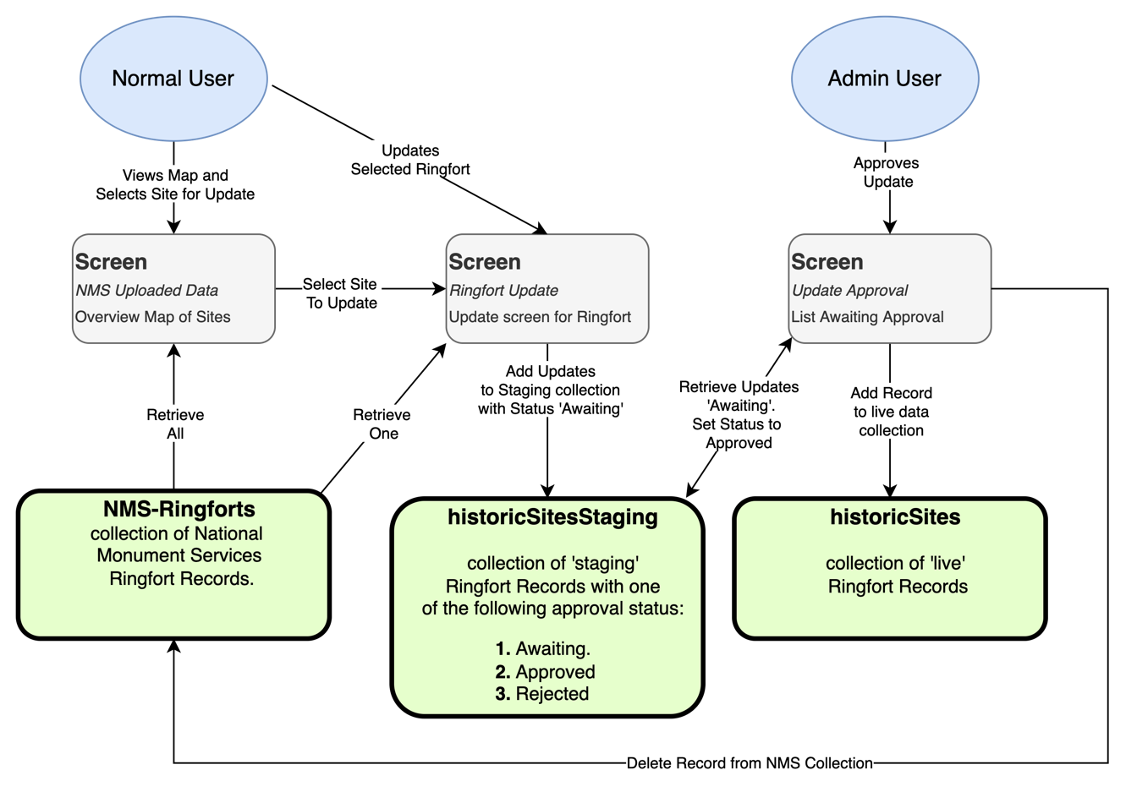
Process and Data Flow
Data Flow

Slide 13
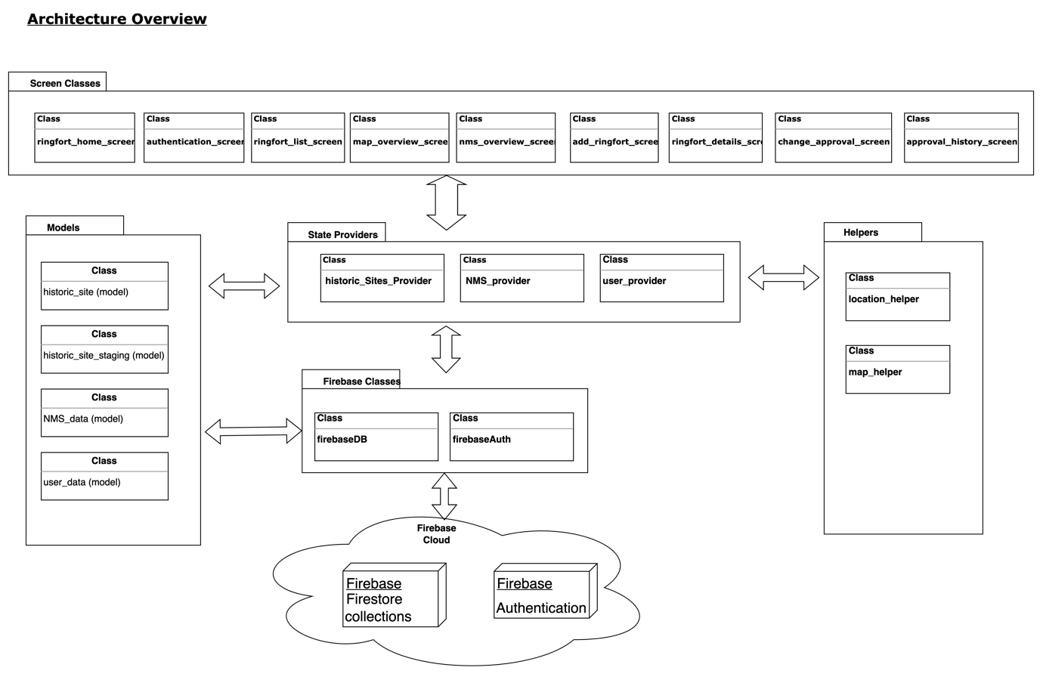
Architecture Overview

Slide 14
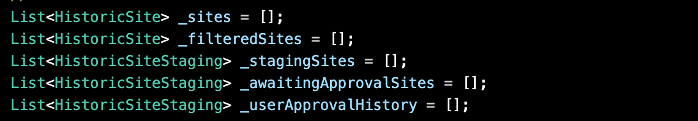
State Management Class HistoricSitesProvider
Class Definition
State Variables
Sample State Methods

Slide 15
What I learnt
Flutter SDK and Dart Programming
Agile Development and Planning
Report Writing

Slide 16
What I achieved
Cross Platform Application
Using NMS data extract
Approval System implementation

Slide 17
Problems I encountered
Building and Installing on IOS
State Management Solution

Slide 18
Possible Future Development
API Backend
Offline Functionality
Store Multiple Images
Built in Unit testing
Adapt for other Subjects matter

Slide 19
Questions?

